Slide 1
List, Table Infographic* … Showing raw data
Exhibit
Explain
Explore
Experience
Data journalism
Report
…
Answering questions
Dashboard
Simulation
…
Finding what to ask
Data art piece
New-media installation
…
Finding meaning in data
Enable
Software for DataViz
…
Building tools to visualize specific use cases

Slide 2
List, Table Infographic* … Showing raw data
Exhibit
Explain
Explore
Experience
Data journalism
Report
…
Answering questions
Dashboard
Simulation
…
Finding what to ask
Data art piece
New-media installation
…
Finding meaning in data
Enable
Software for DataViz
…
Building tools to visualize specific use cases

Slide 3
Data visualization for exhibiting data

Slide 4
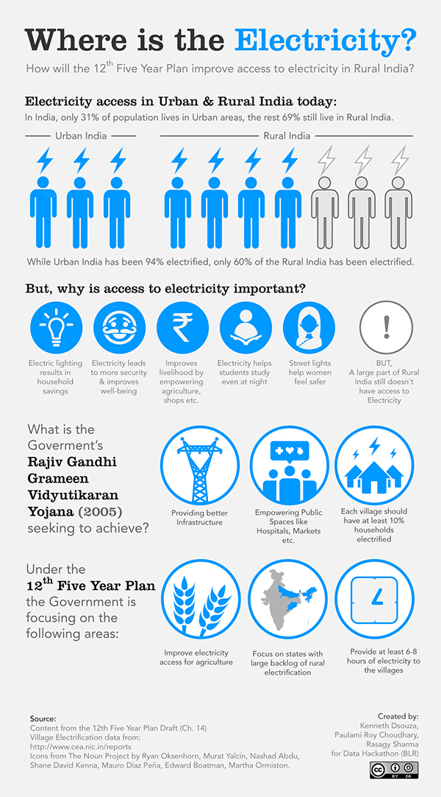
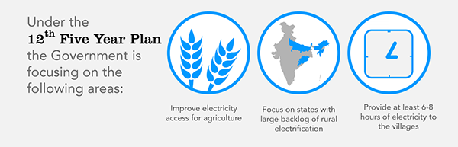
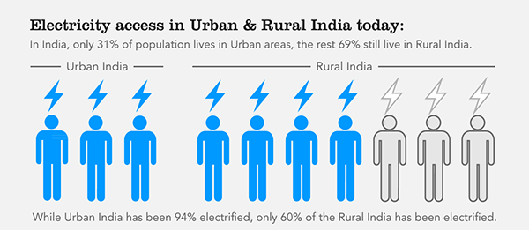
What is the focus of 12th Five Year Plan for electricity in rural India?
Data.gov.in Data Hackathon (2014)

Slide 5
Data visualization for explaining an insight

Slide 6
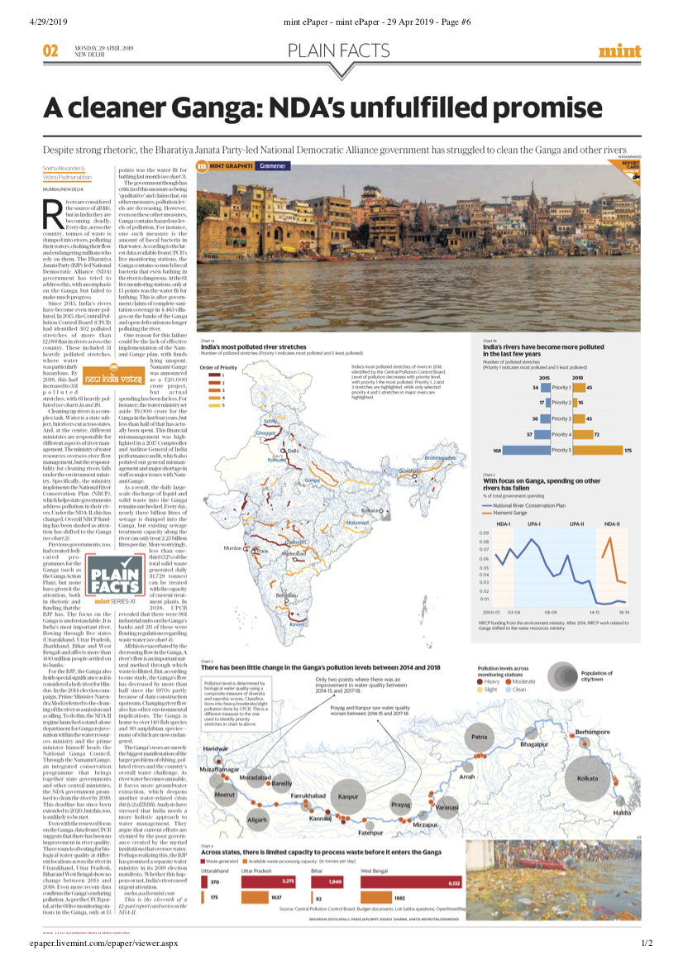
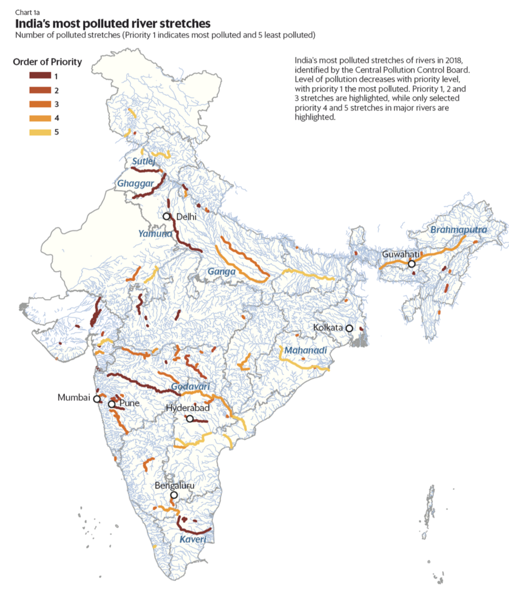
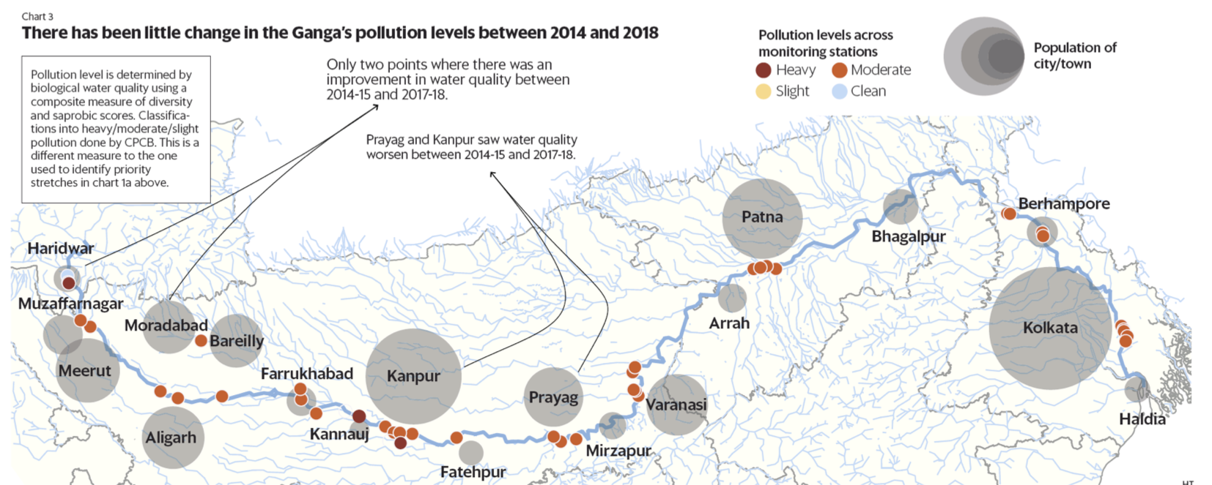
What has been the impact of NDA’s focus on Ganga?
Collaboration with Mint (2019)

Slide 7
Data visualization for explaining what is unseen

Slide 8
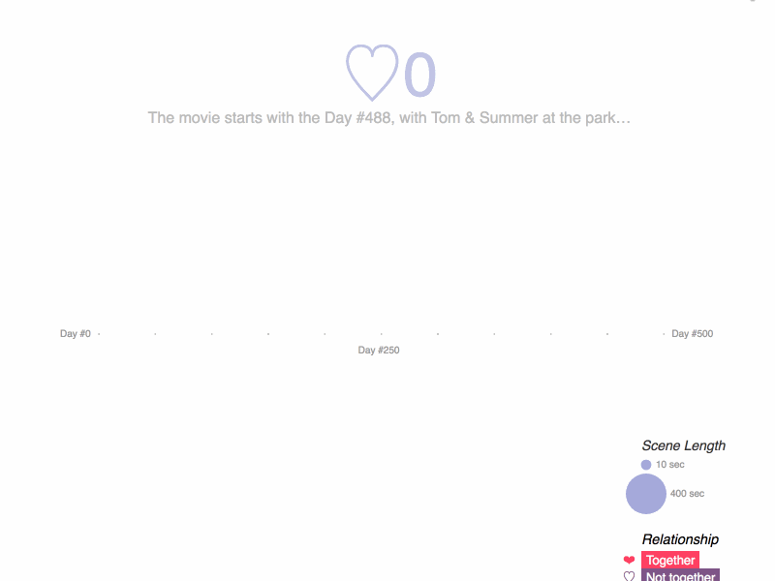
What made the non-linear narrative of 500 Days of Summer interesting?
Visualization of a movie narrative (2013)

Slide 9
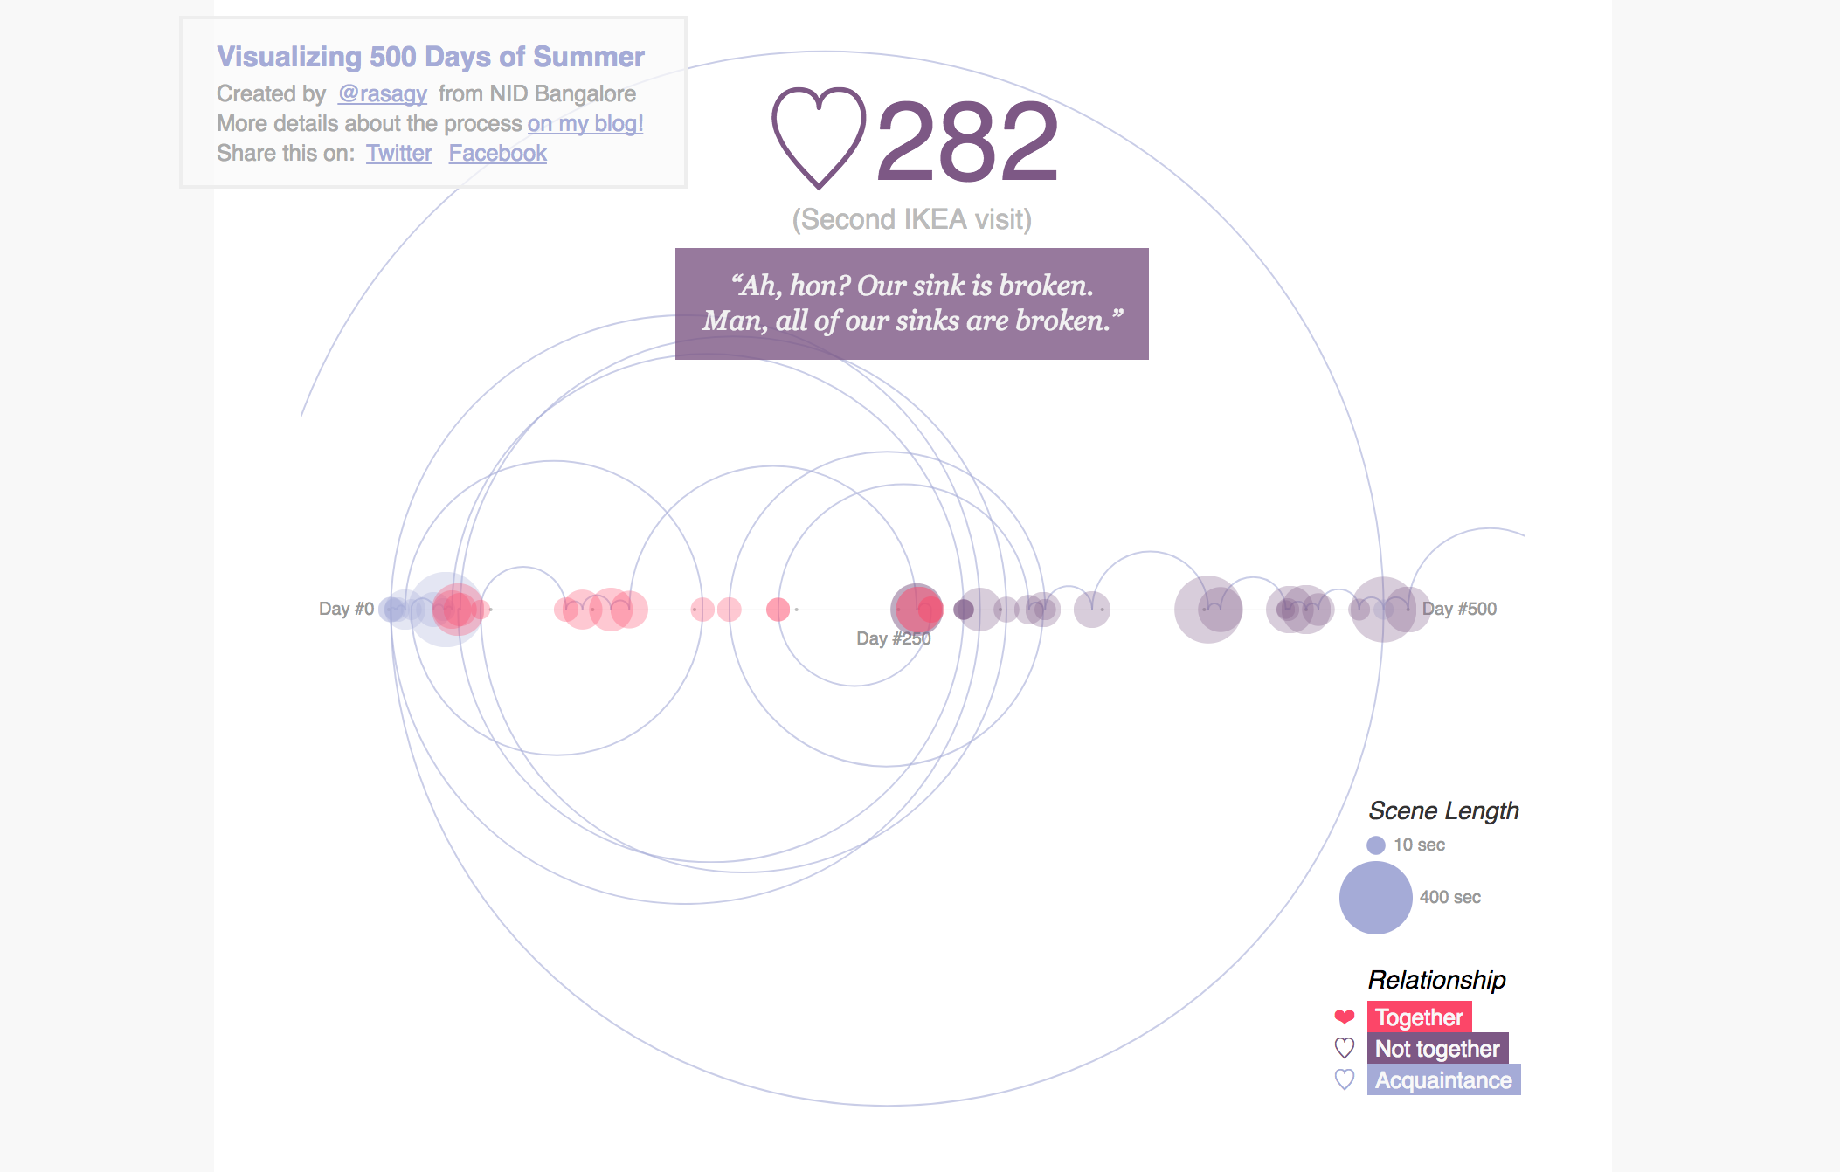
What made the non-linear narrative of 500 Days of Summer interesting?
Visualization of a movie narrative (2013)

Slide 10
Data visualization for exploring questions

Slide 11
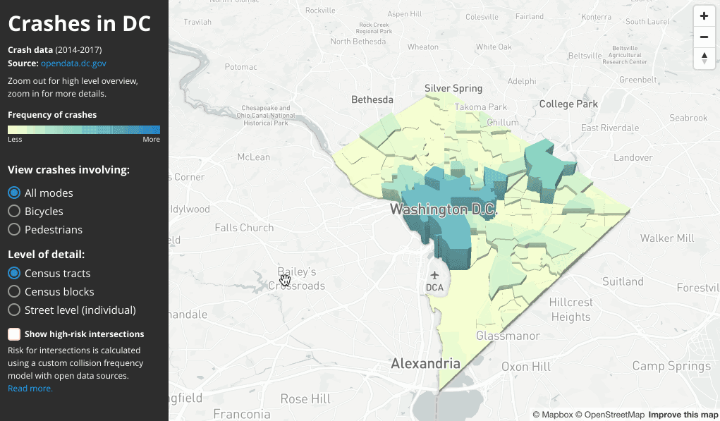
Where did traffic accidents happen the most in DC?
Collaboration with DoT for Vision Zero project (2017)

Slide 12
Data visualization for building a narrative

Slide 13
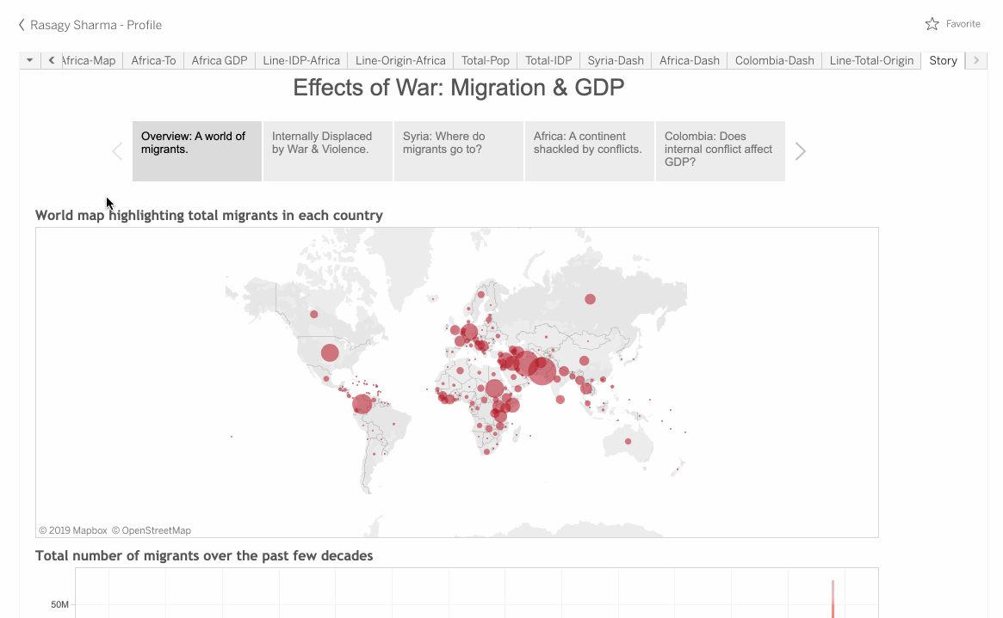
How did war impact migration & GDP?
Winning entry in MADTA hackathon (2015)
(Individual project)
Process:
Data analysis in Excel Map-based storytelling using Tableau
View Tableau Dashboard

Slide 14
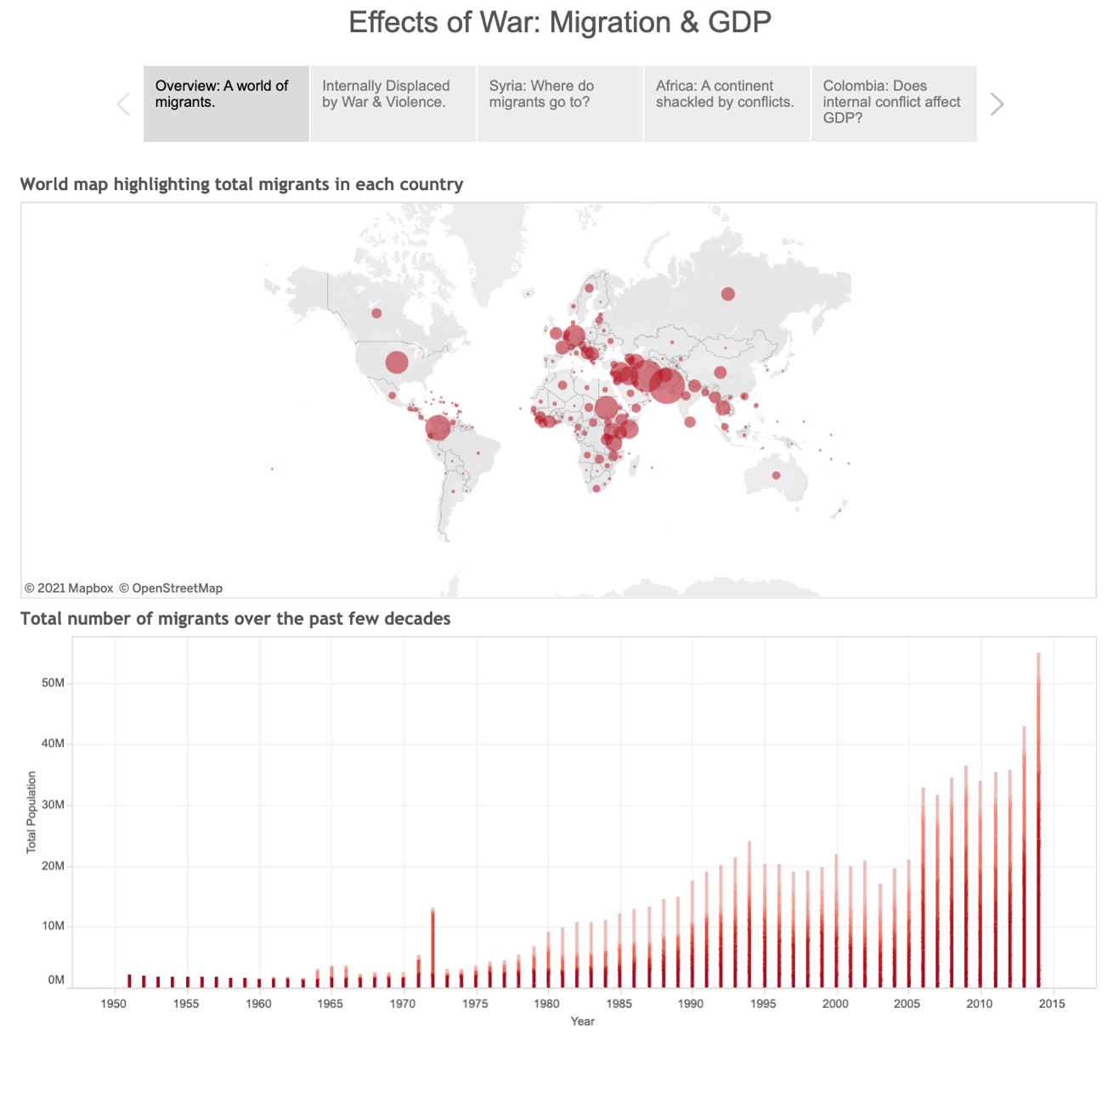
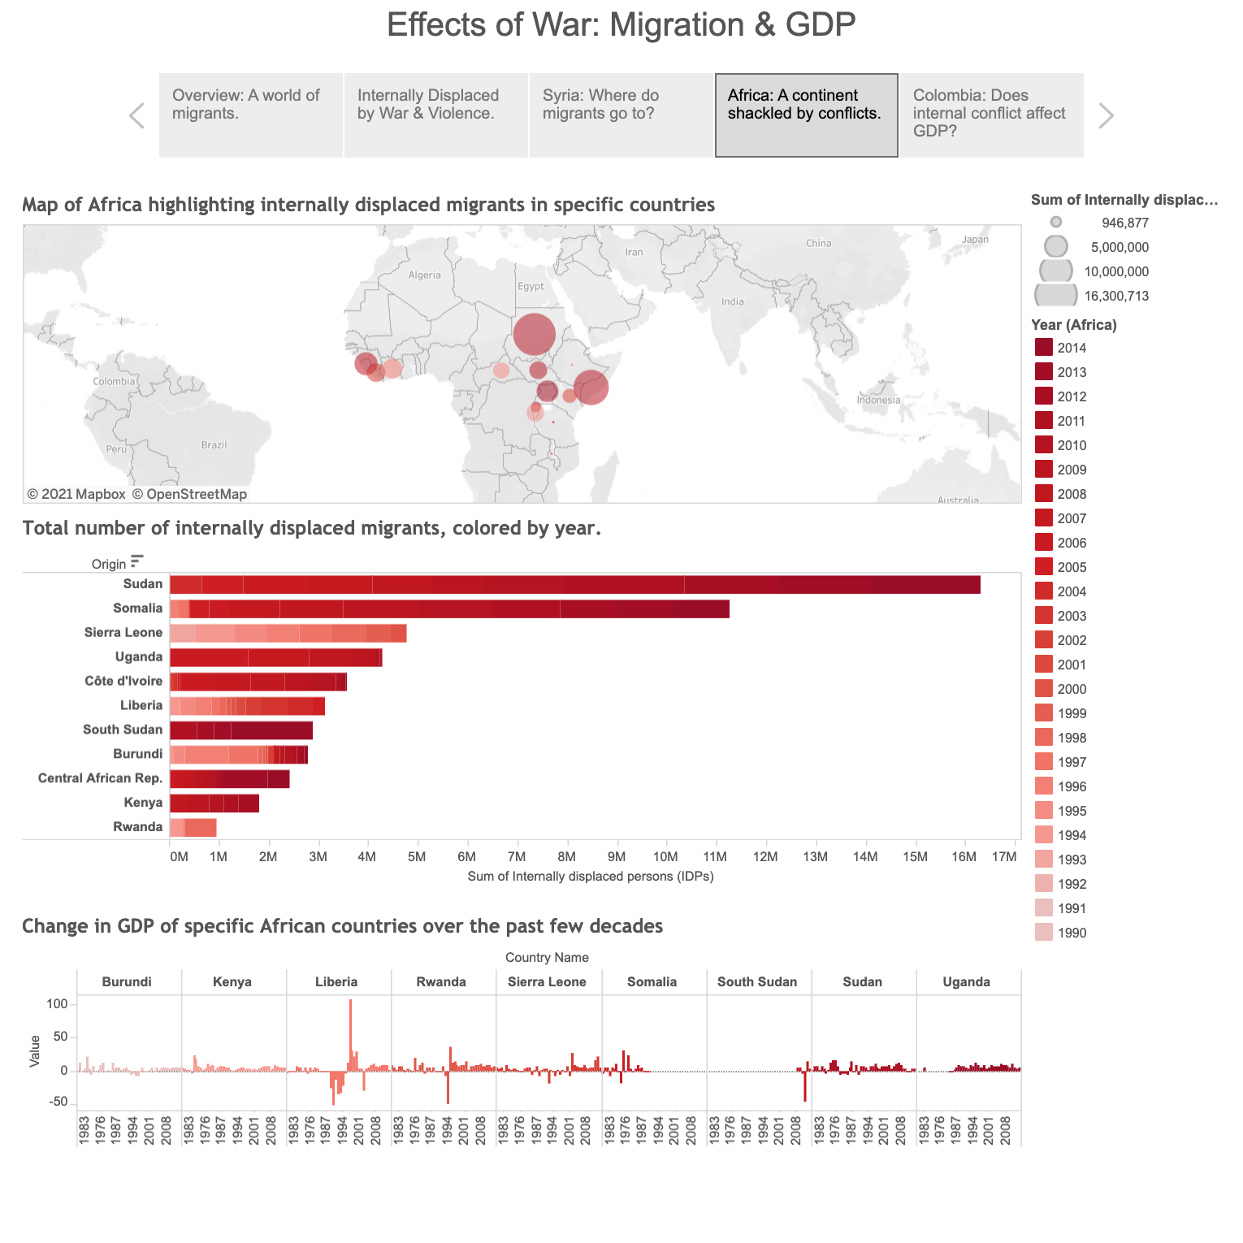
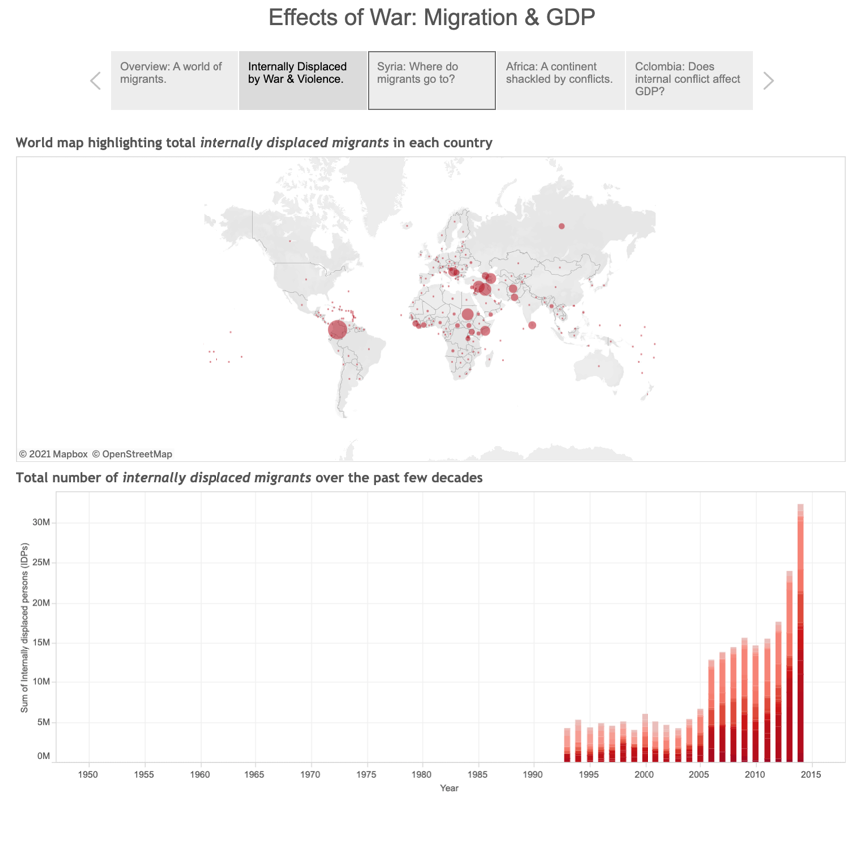
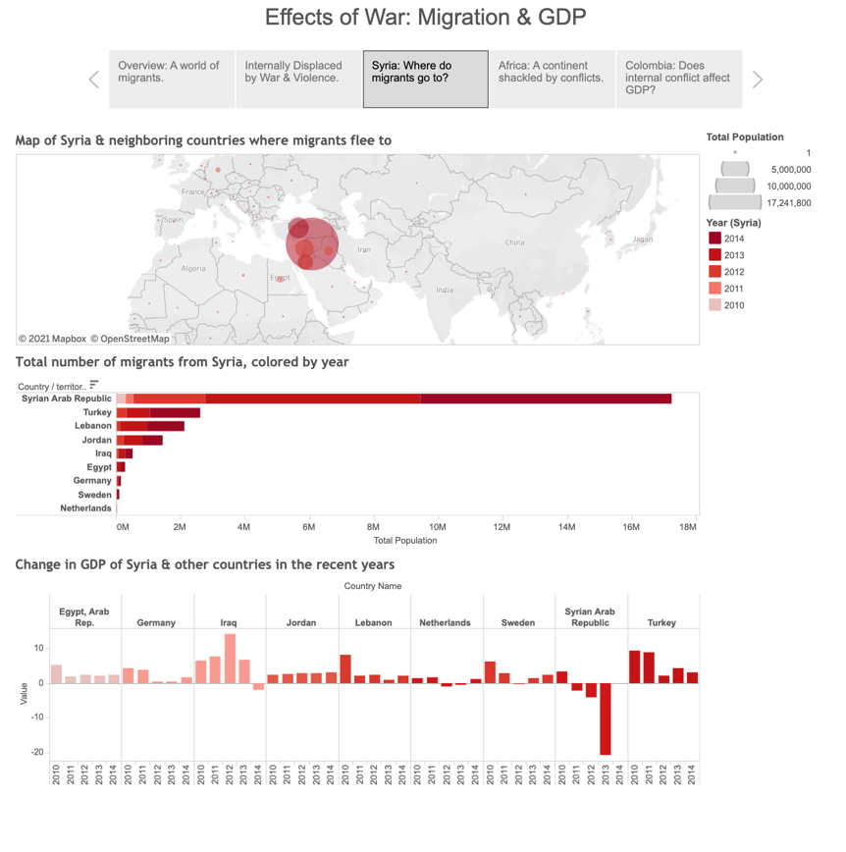
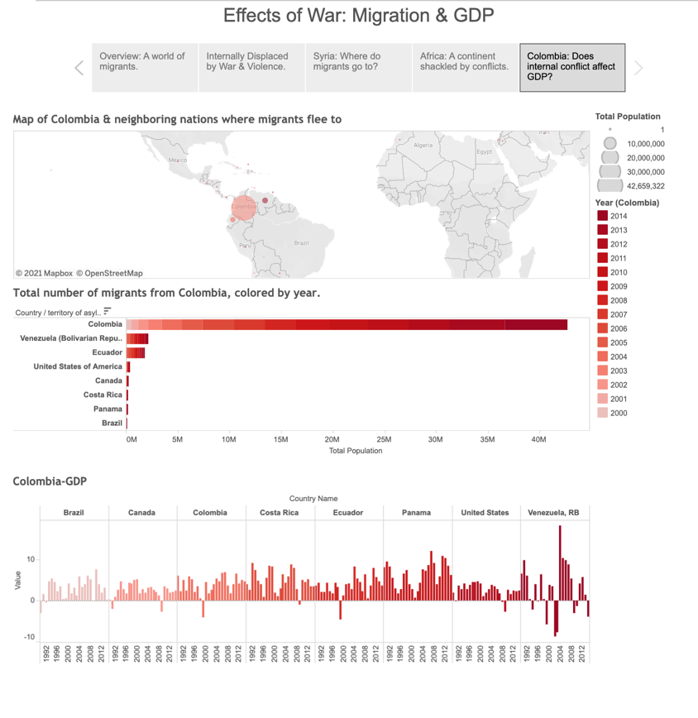
How did war impact migration & GDP?
Winning entry in MADTA hackathon (2015)
(Individual project)
Process:
Data analysis in Excel Map-based storytelling using Tableau
View Tableau Dashboard

Slide 15
Data visualization for provoking discourse

Slide 16

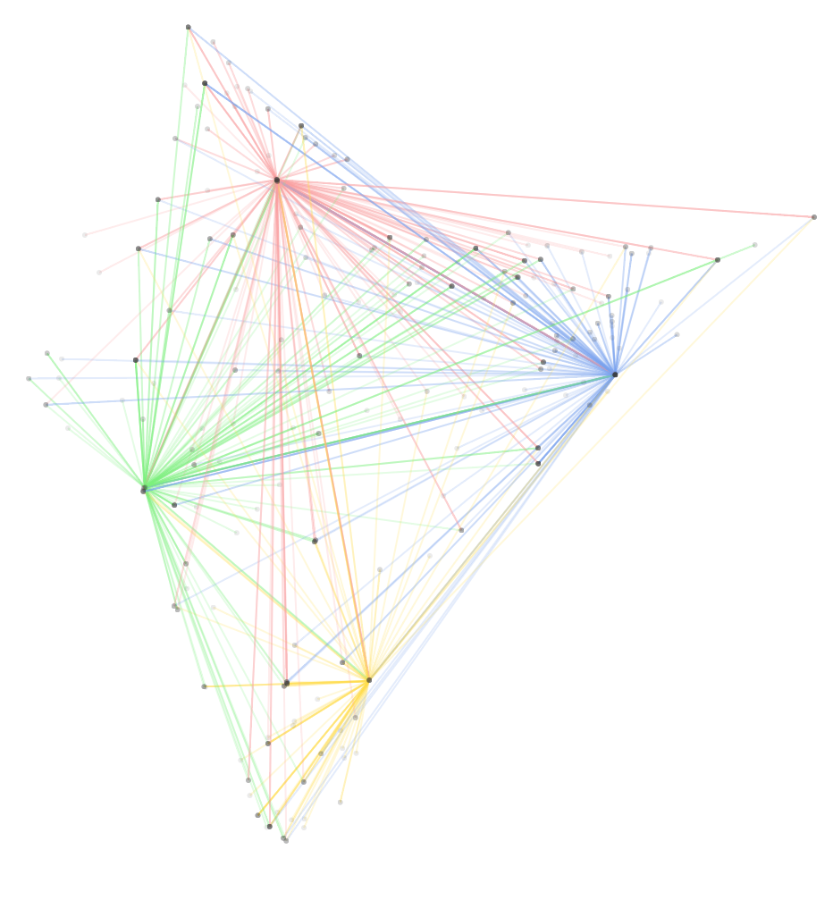
How are the major metros connected with the rest of the country?
Visualizing trains from Indian Metros (2013)

Slide 17
Data visualization for self-reflection

Slide 18

How do memories shape our image of a city?
This was once home: Experimental cartography project with Mapbox (2018)

Slide 19
Data visualization for exploring stories about stories

Slide 20
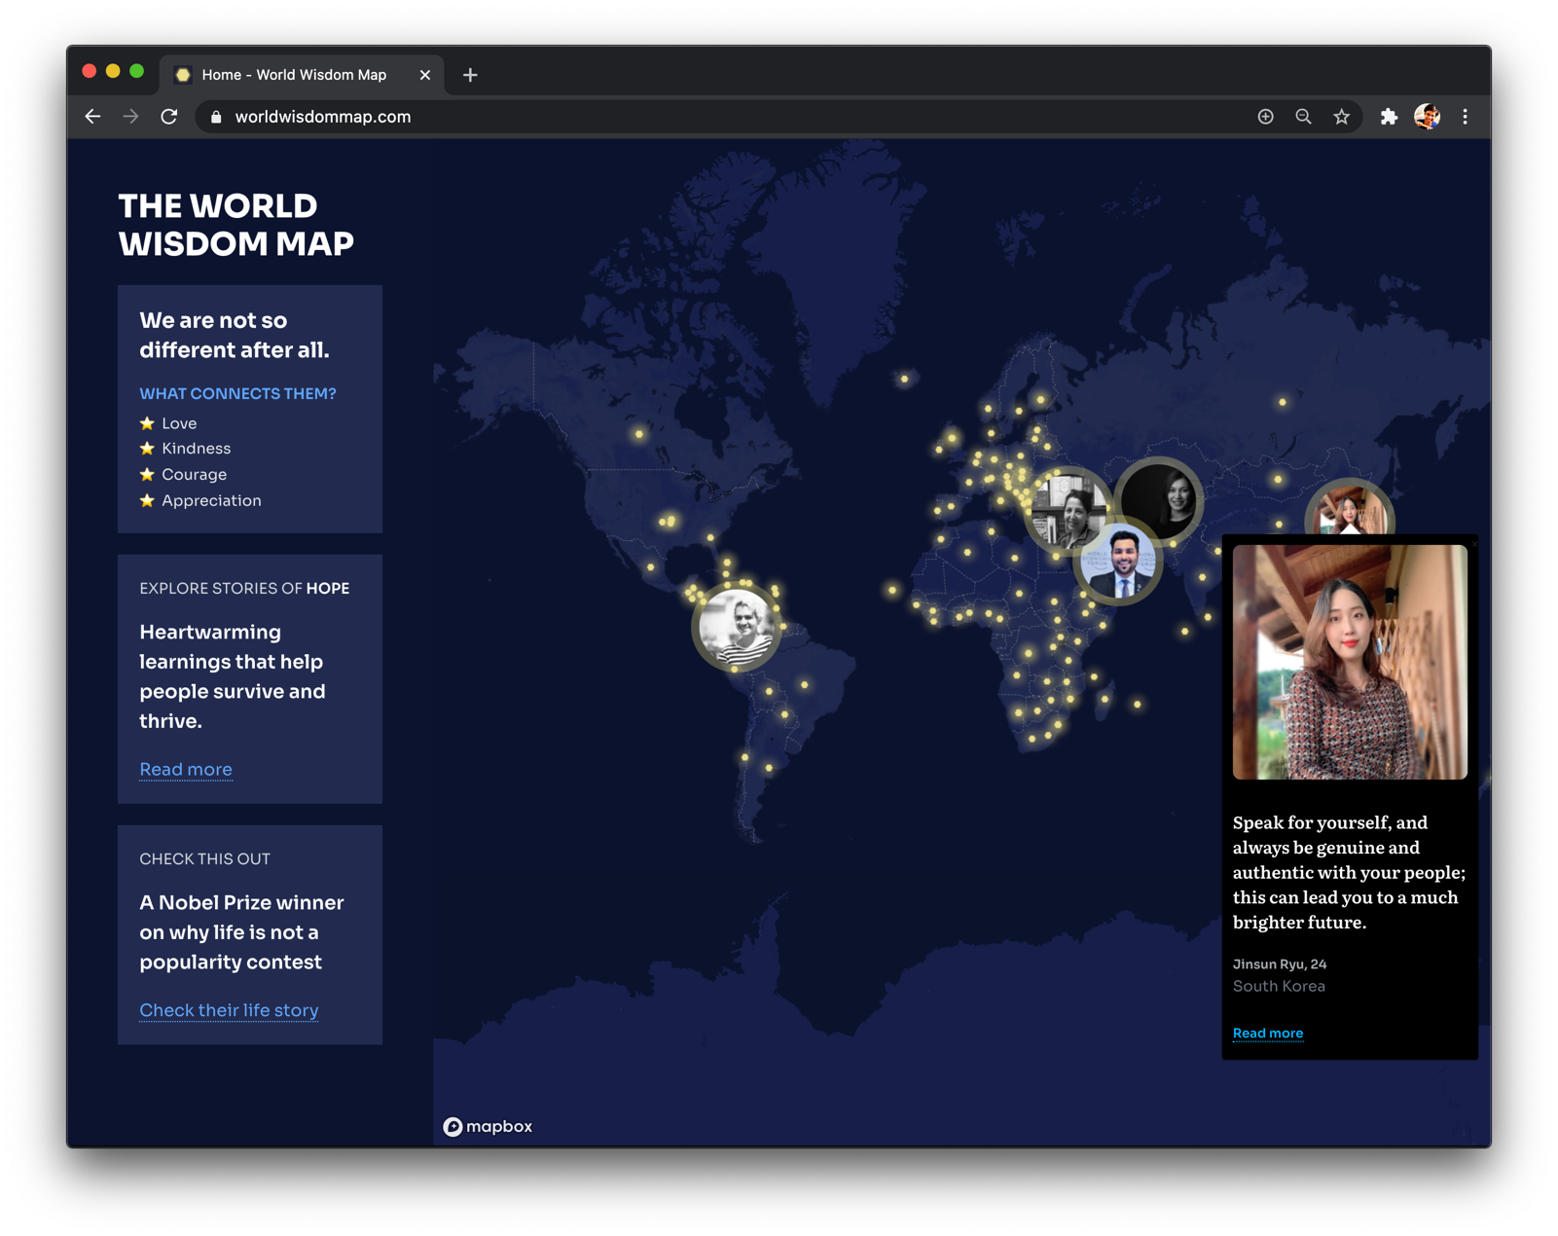
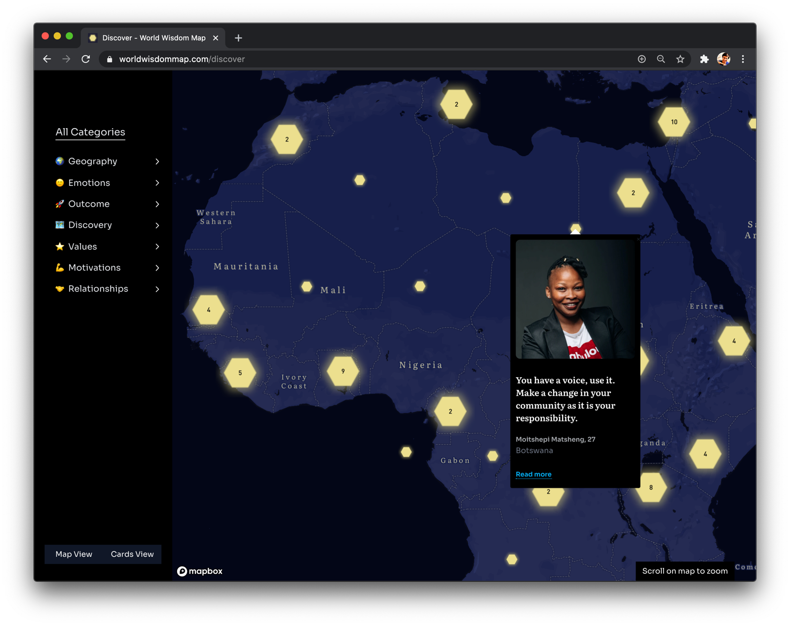
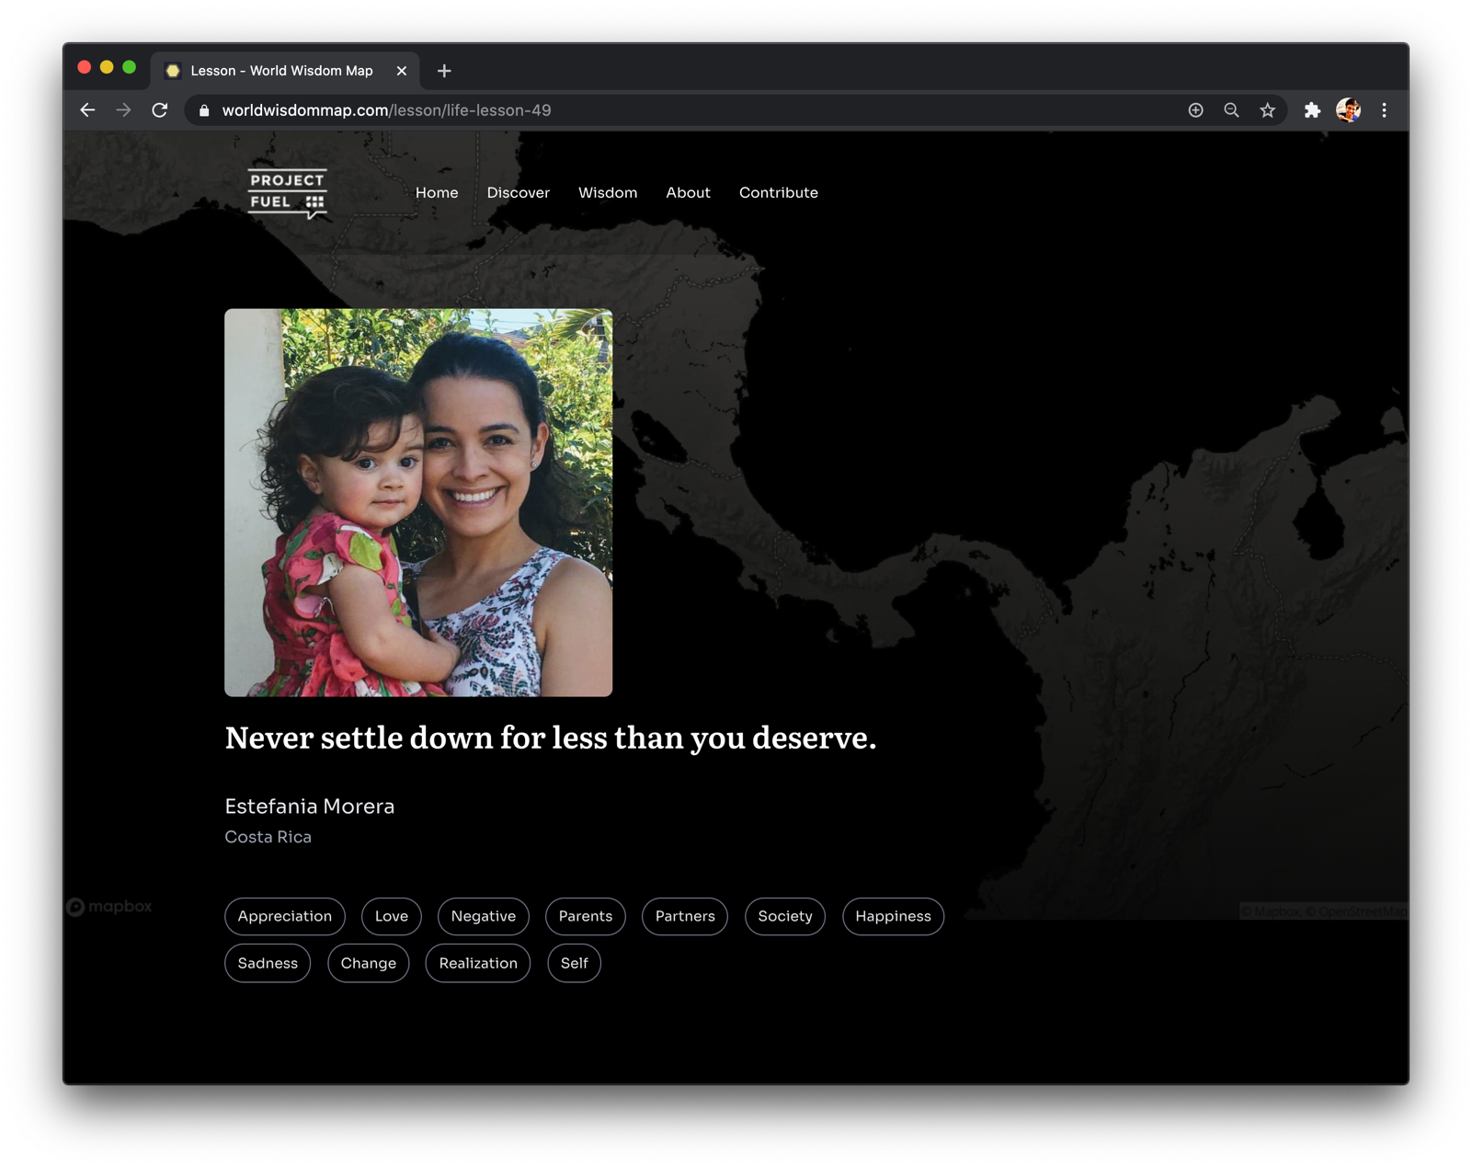
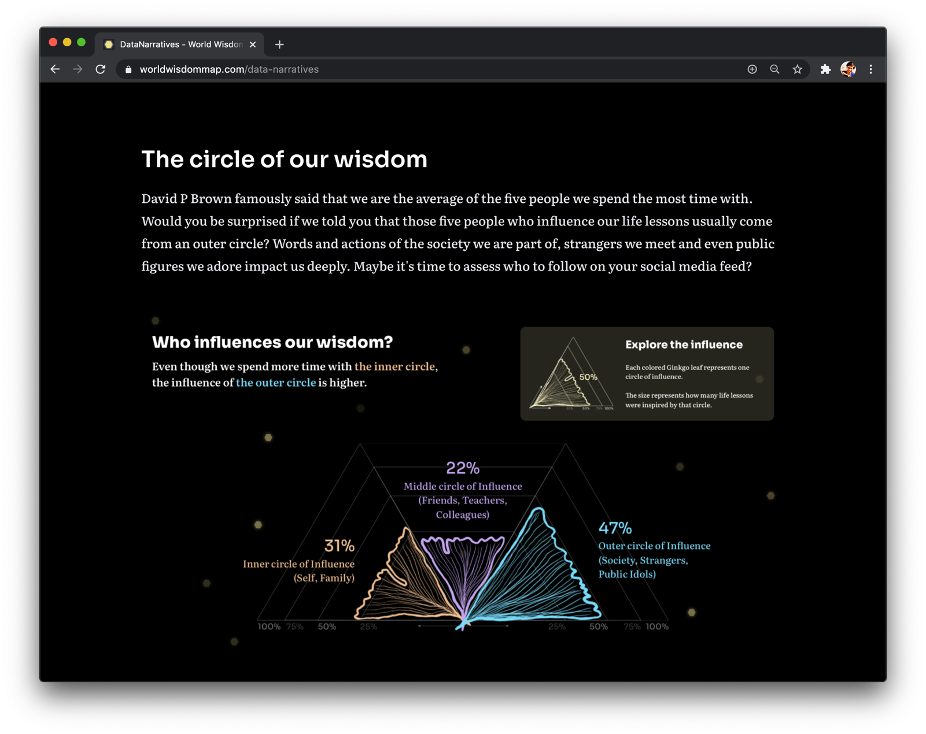
What would a map of wisdom from around the world look like?
Collaboration with Project FUEL (2020)

Slide 21
Data visualization for expressing what isn’t ‘data’

Slide 22
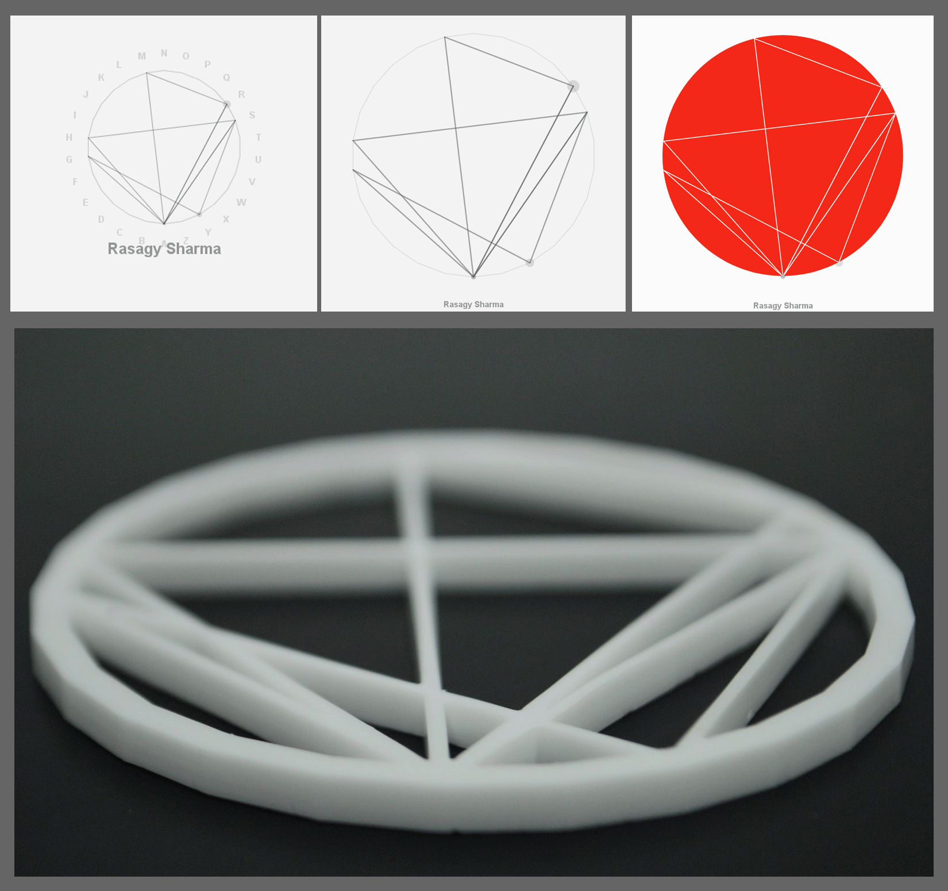
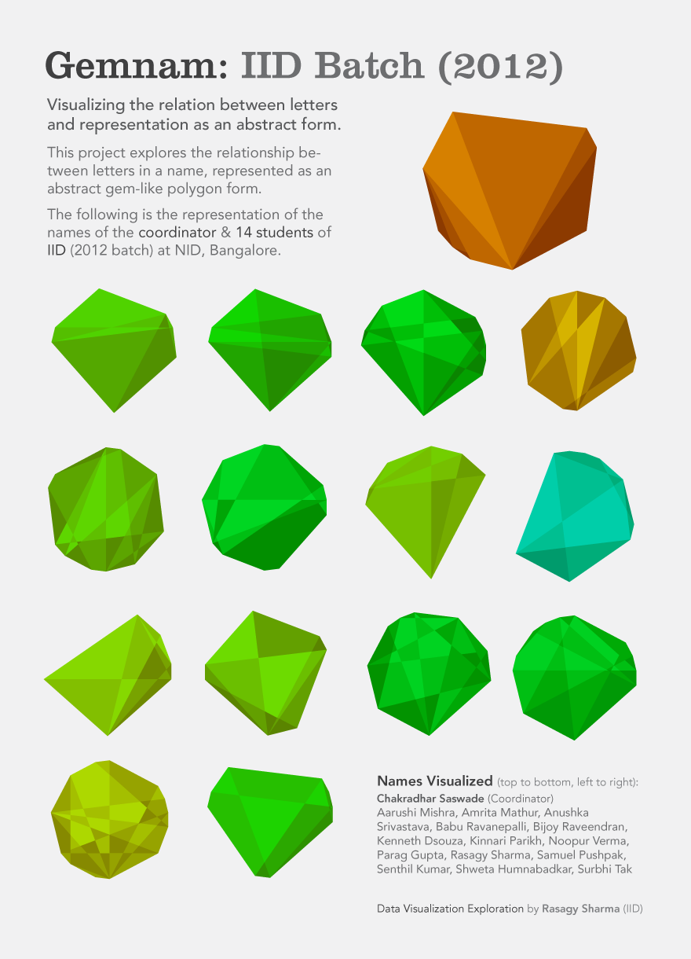

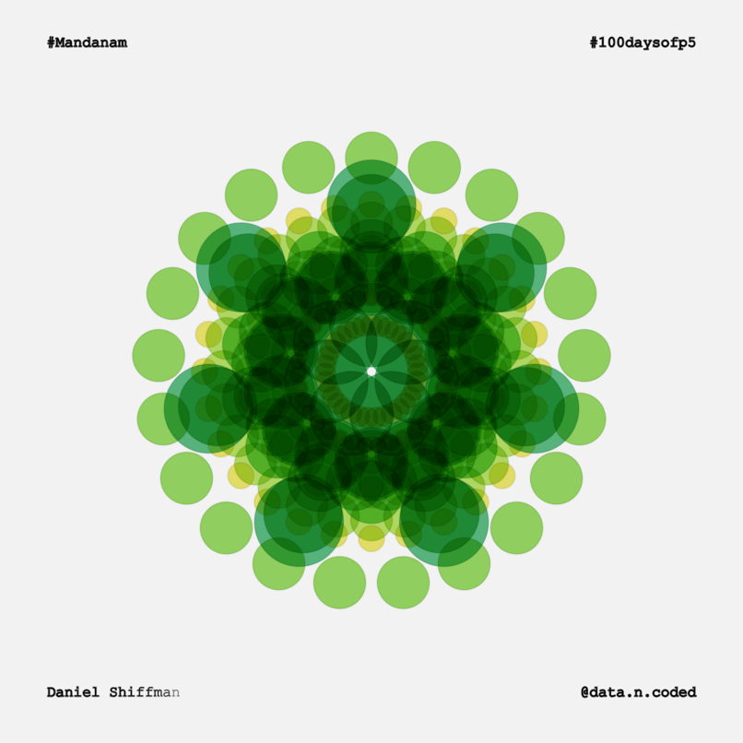
Can we create abstract data art from names?
Experimental data art projects (2013–19) (Circonam, Mandanam & Gemnam)

Slide 23
“Most of us need to listen to the music to understand how beautiful it is. But often that’s how we present statistics: we just show the notes, we don’t play the music.” — Hans Rosling

